Slide 1
Body Performance
Philip Lam
January 28, 2022

Slide 2
Introduction
The fitness industry is one of the biggest industries in the world. In 2021 the fitness industry in the United States has generated more than 30 billion U.S. dollars.
Data was collected by the national sports promotion agency at the seoul Olympics of people ages 20-64.
are we able to predict which age group and gender have a poor body performance? With the information, we can pitch this to the fitness industry to focus on that specific group to help attract them to get a better body performance for their age.

Slide 3
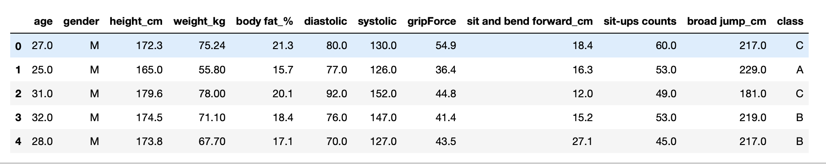
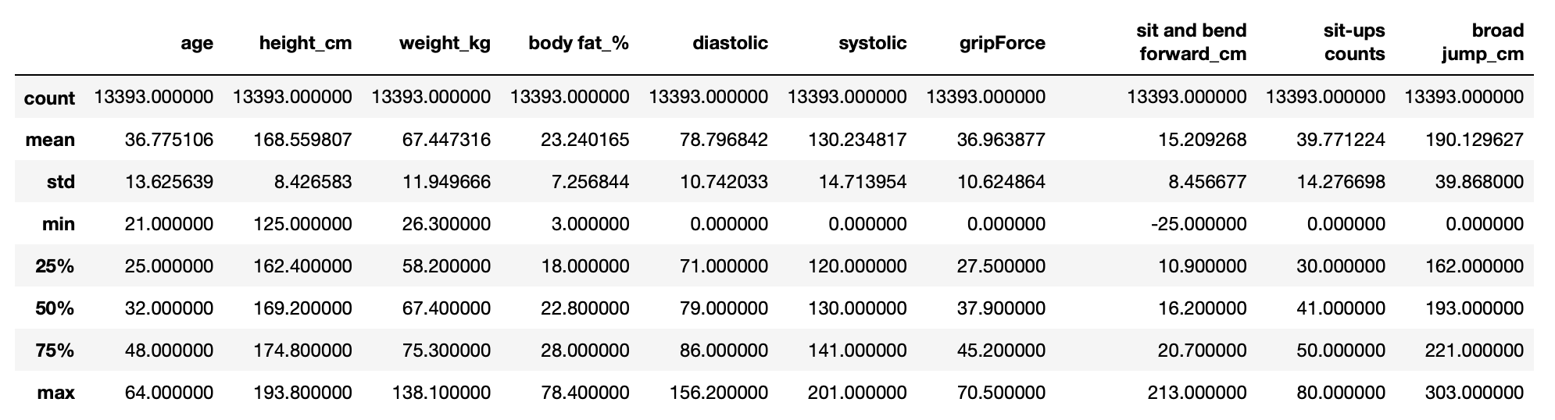
Data acquisition and wrangling​
Notes:
Class = grade of performance set by the institution. A= first grade, B= second grade, C= third, D= attend

Slide 4
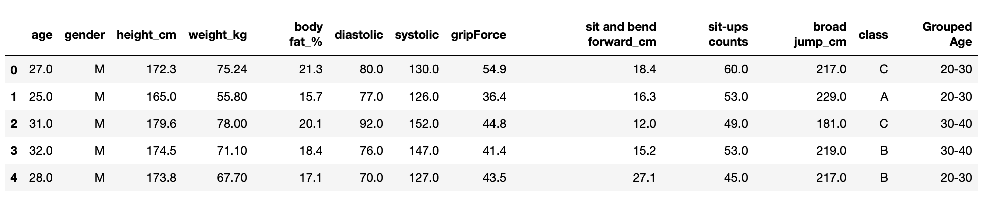
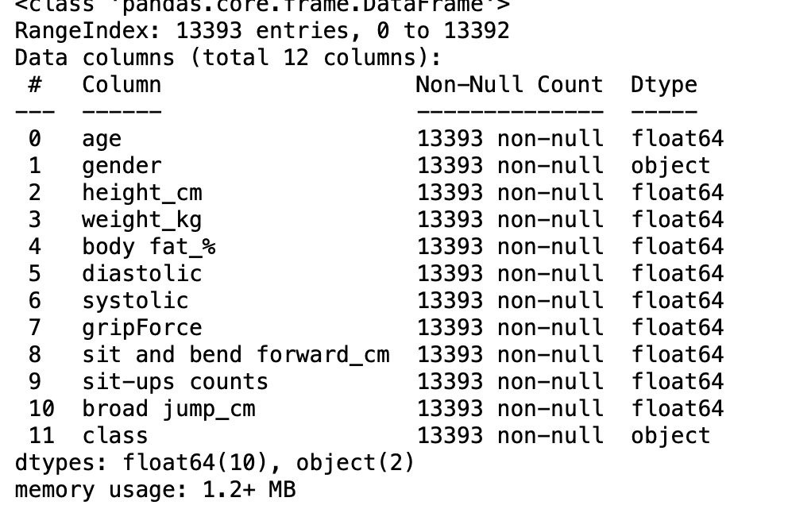
The data set was obtained through Kaggle (https://www.kaggle.com/kukuroo3/body-performance-data).
Notes:
Group the ages in increment of 10.

Slide 5
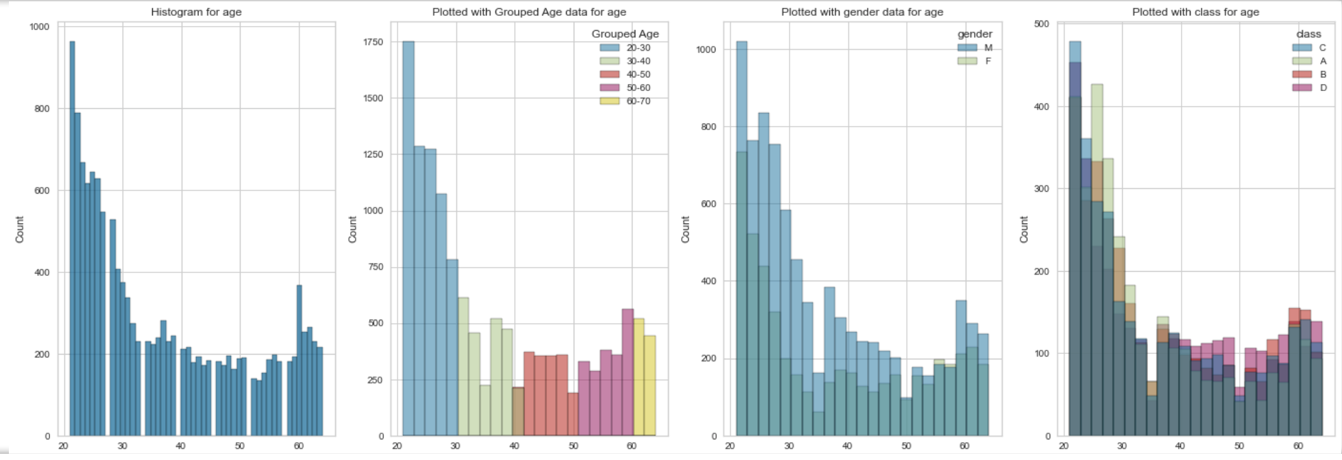
Exploratory analysis

Slide 6
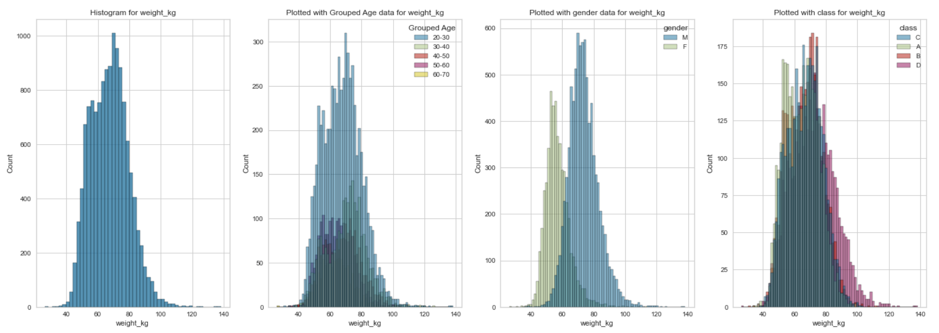
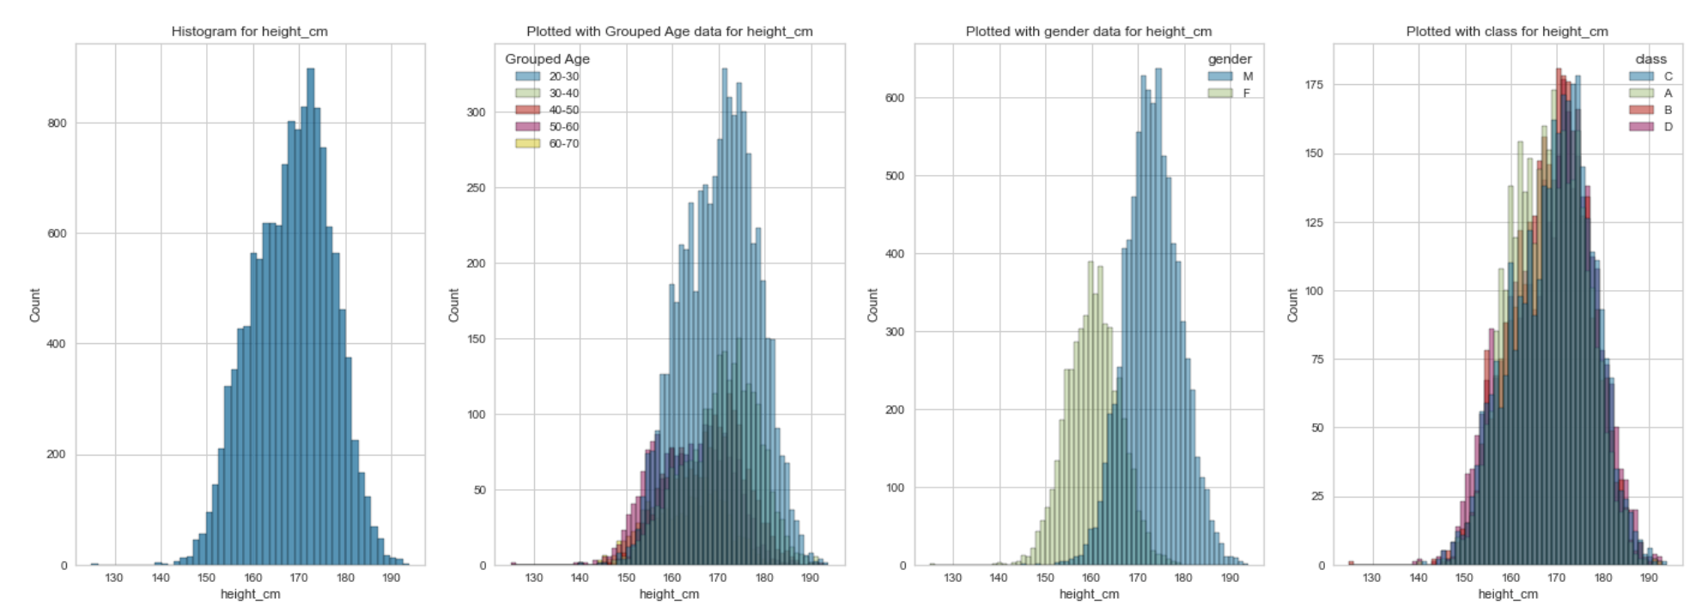

Slide 7
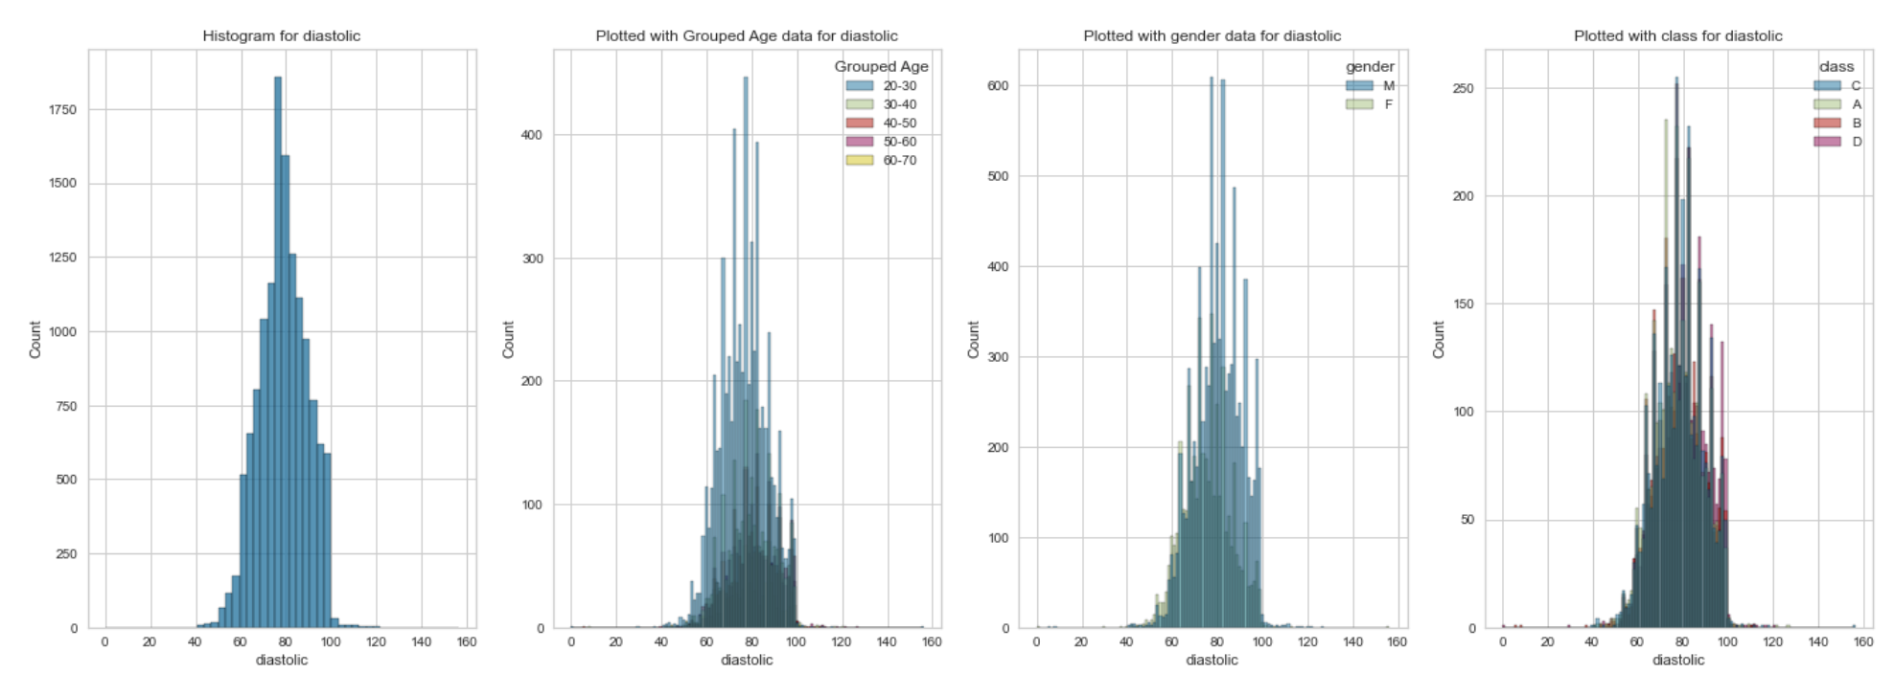
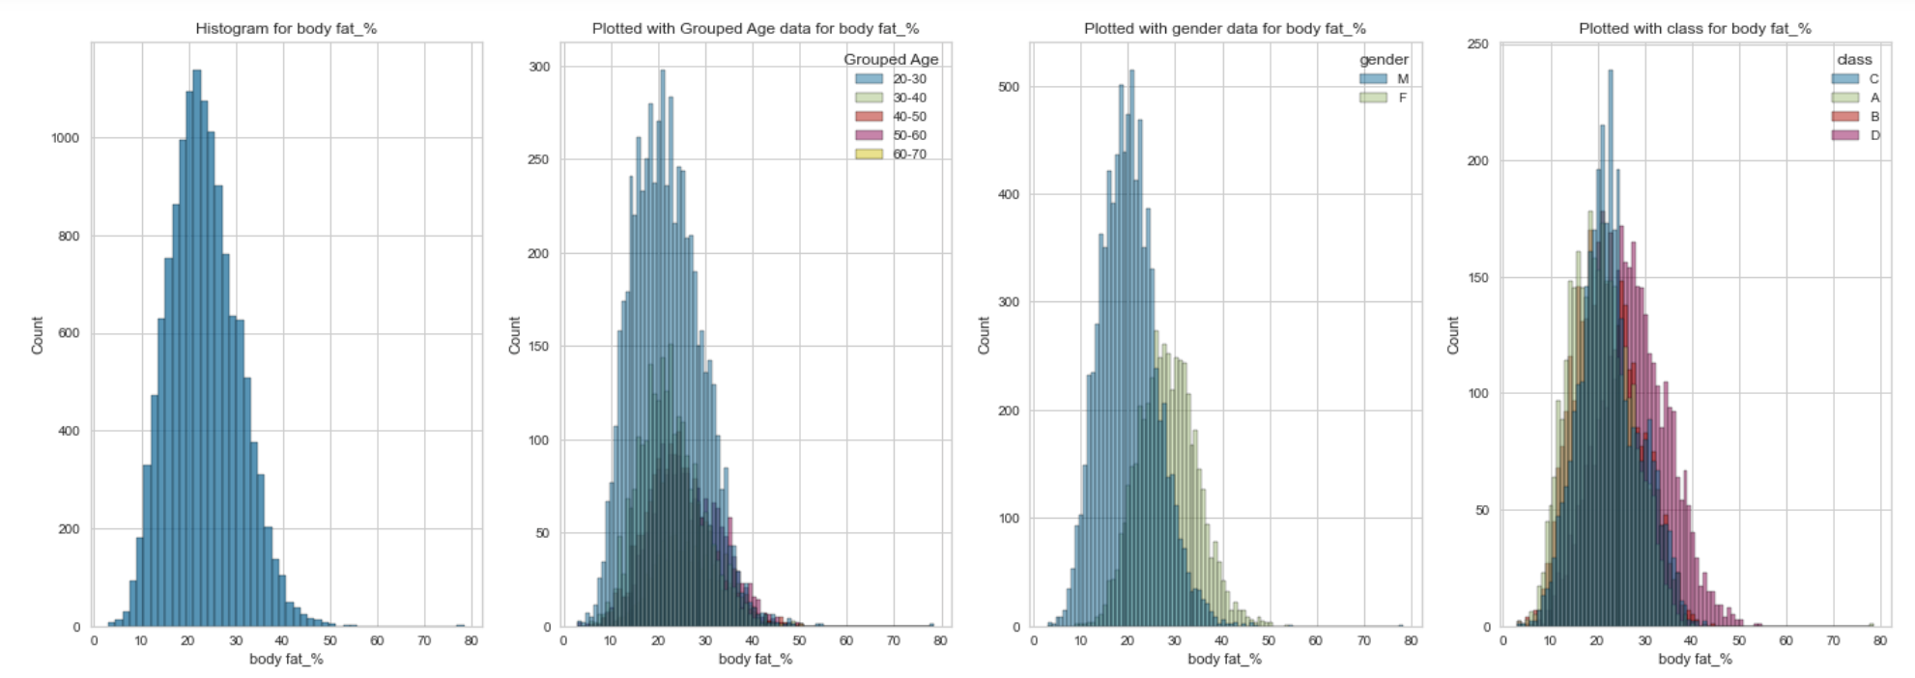

Slide 8
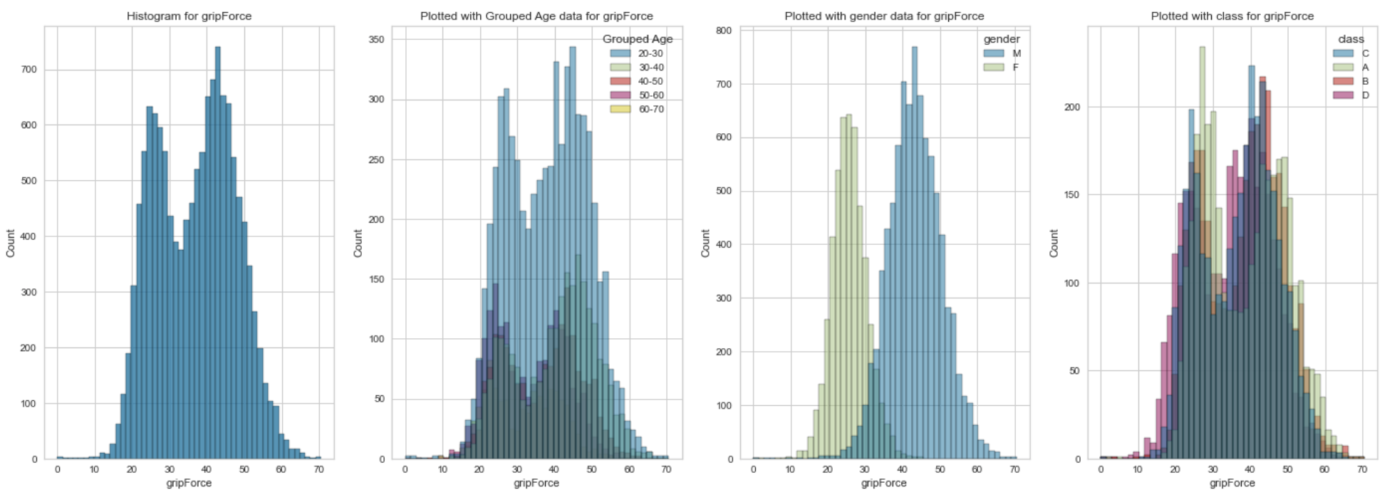
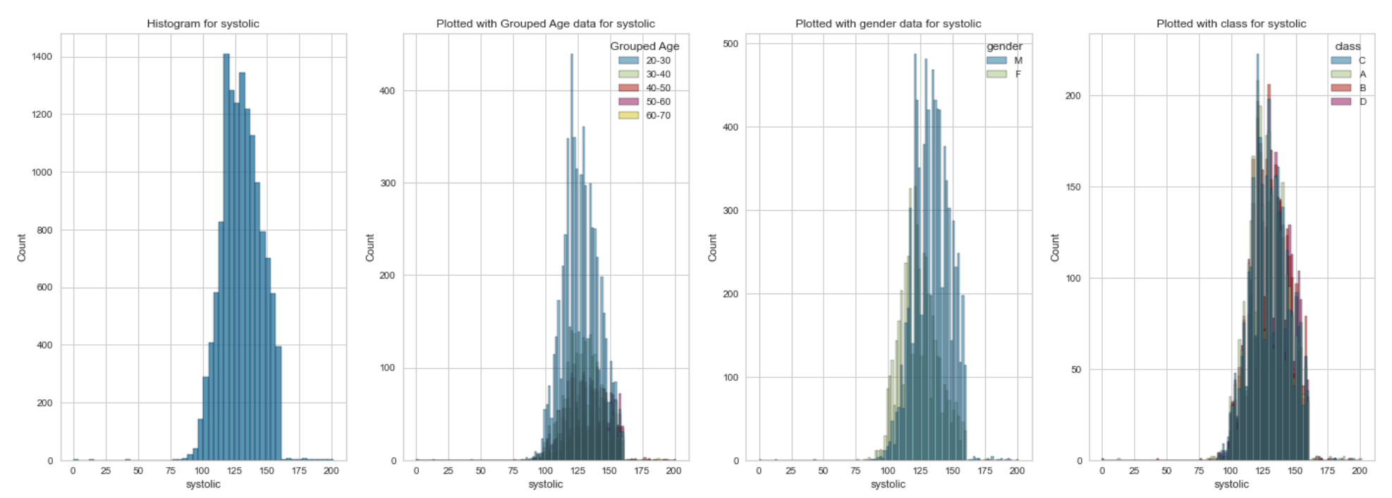

Slide 9
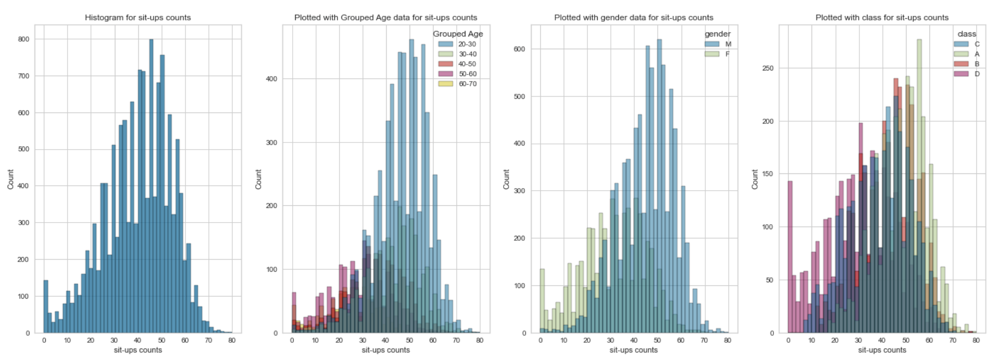
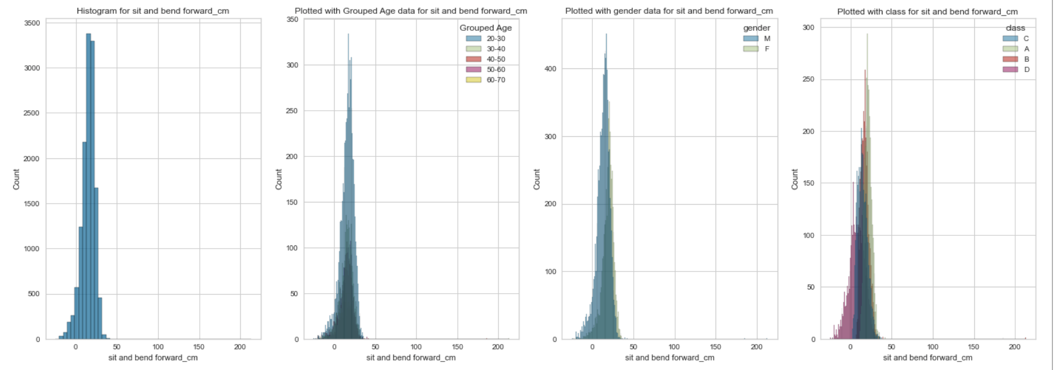

Slide 10
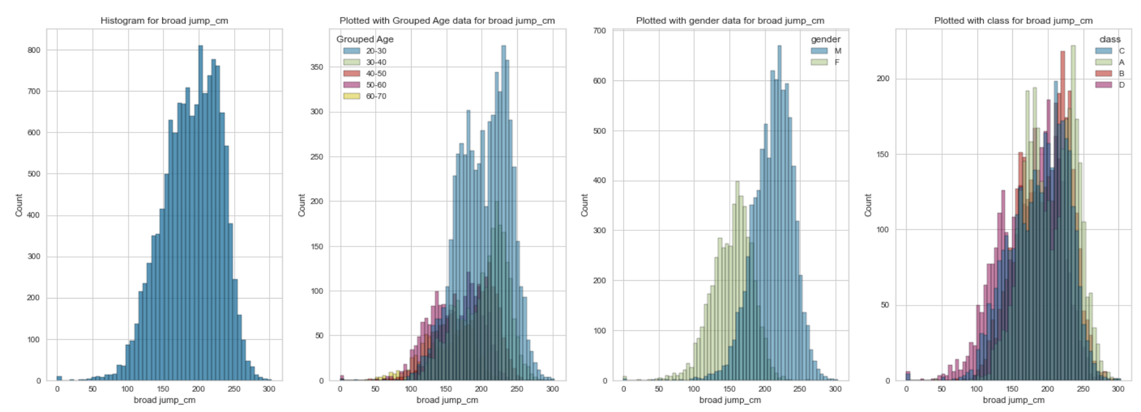

Slide 11
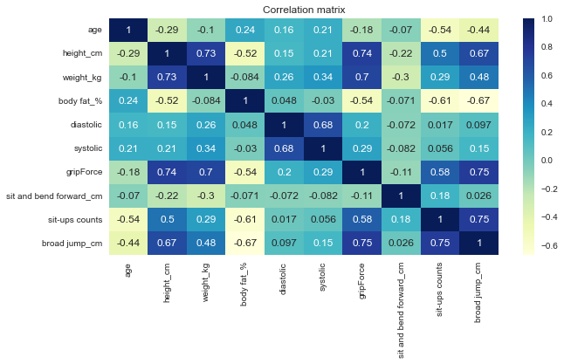
Notes:
I did a correlation matrix but seeing the correlation on some of these categories may seem odd or inaccurate. I realize this maybe because correlation matrix works well with numerical variables. So I did predictive power score (next slide) to get another reading.

Slide 12
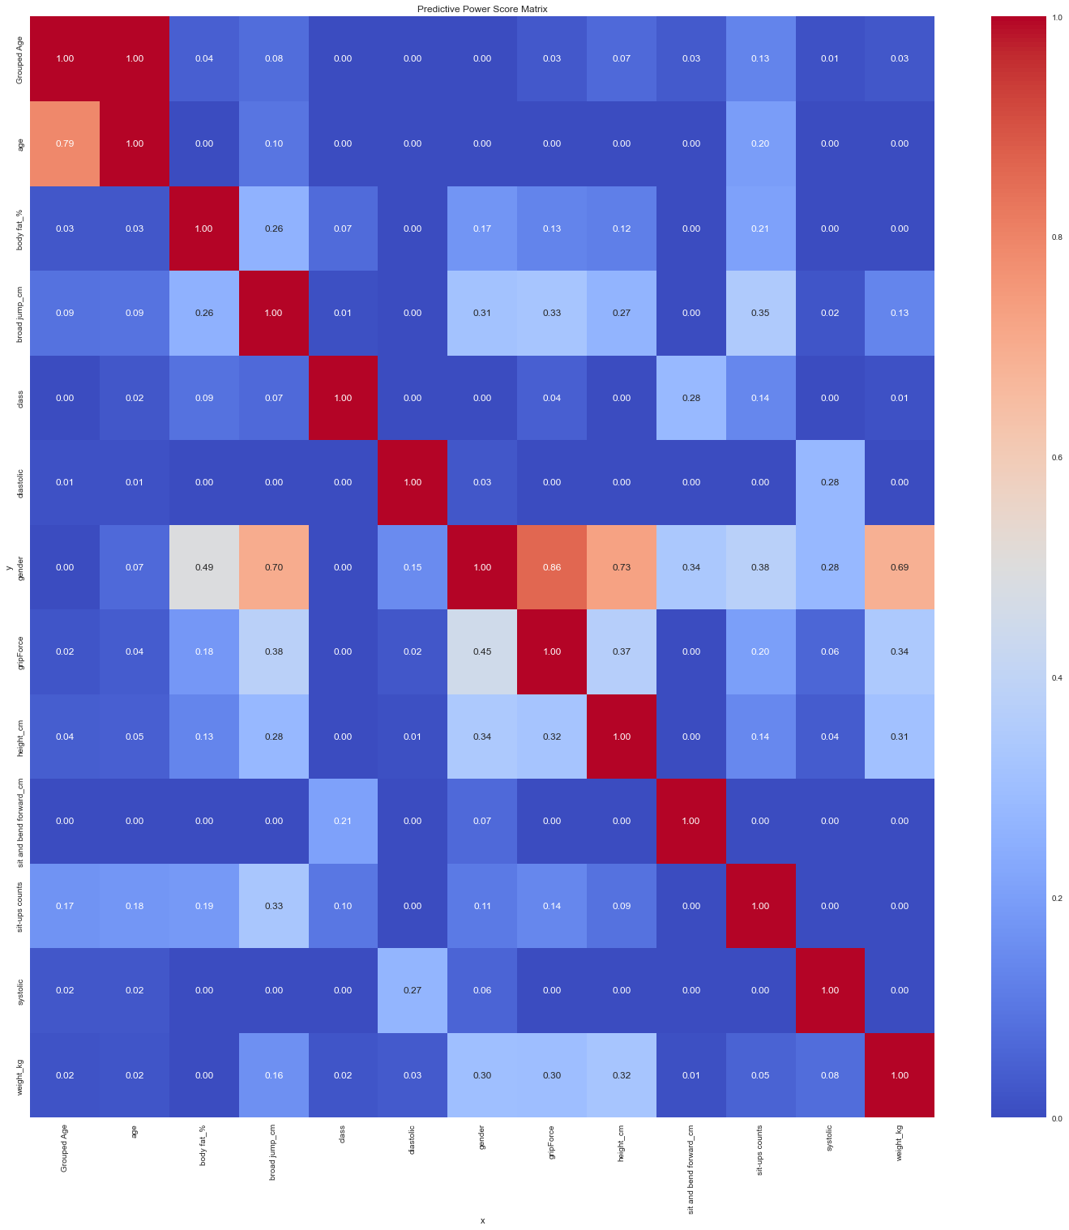
Notes:
Gender – broad jump = .70
Gender – grip force = .86
Gender – height = .73
Gender – weight = .69

Slide 13
Training and modeling

Slide 14
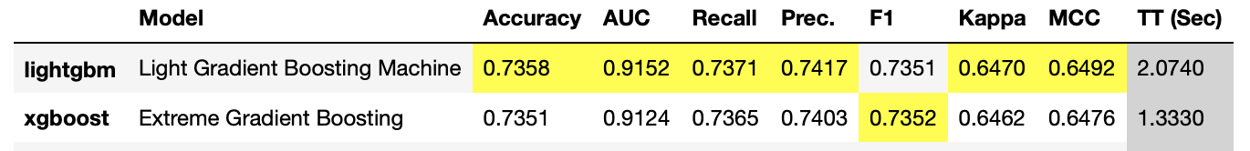

Slide 15
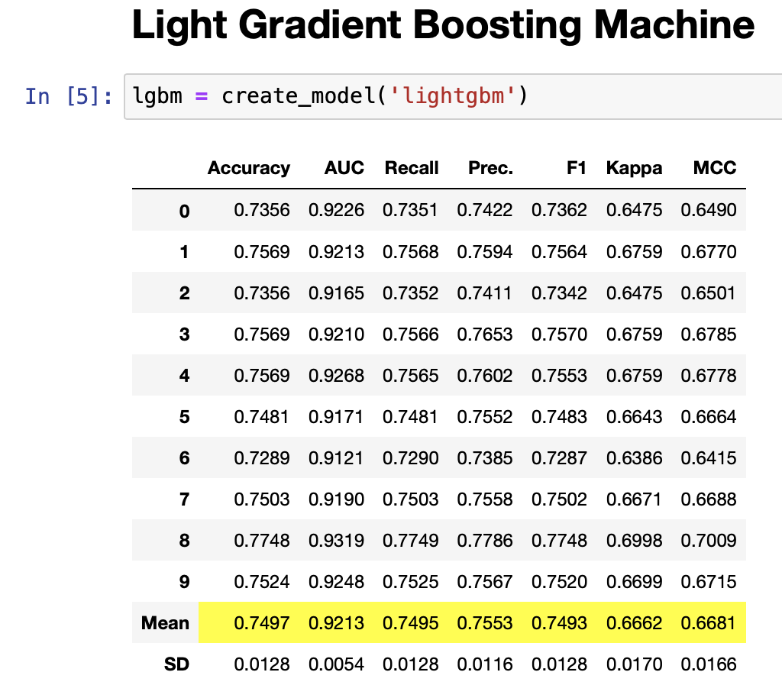
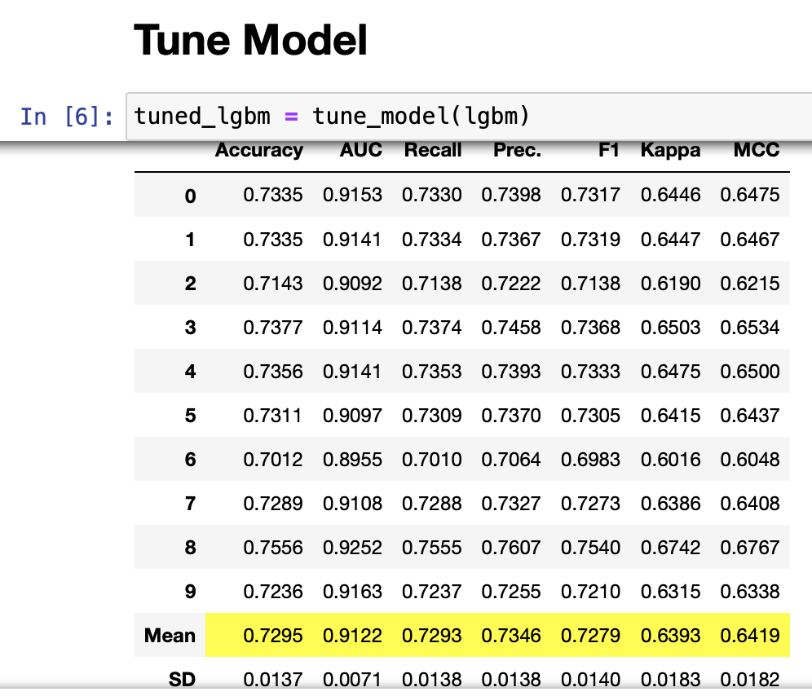
Modeling

Slide 16
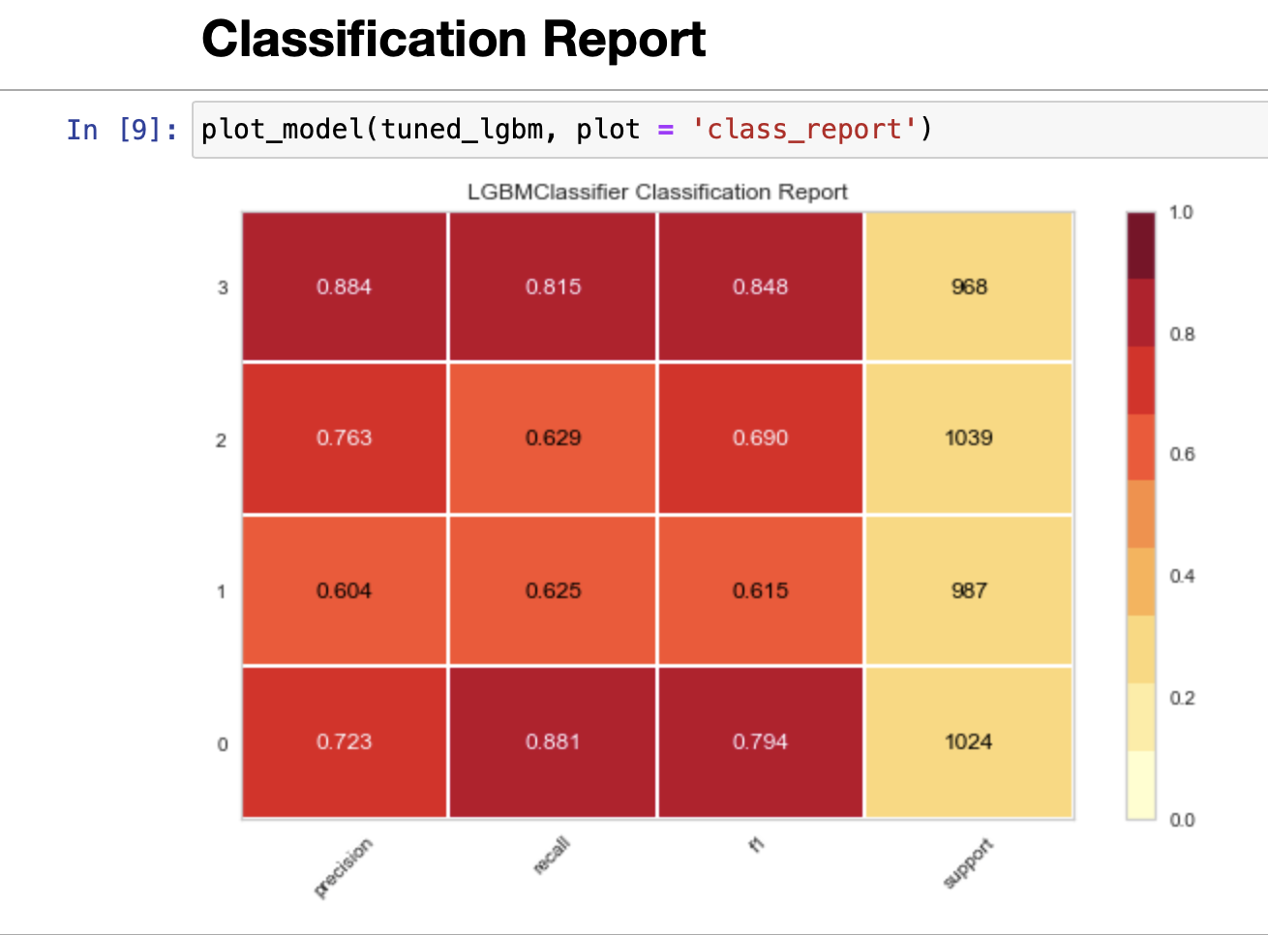
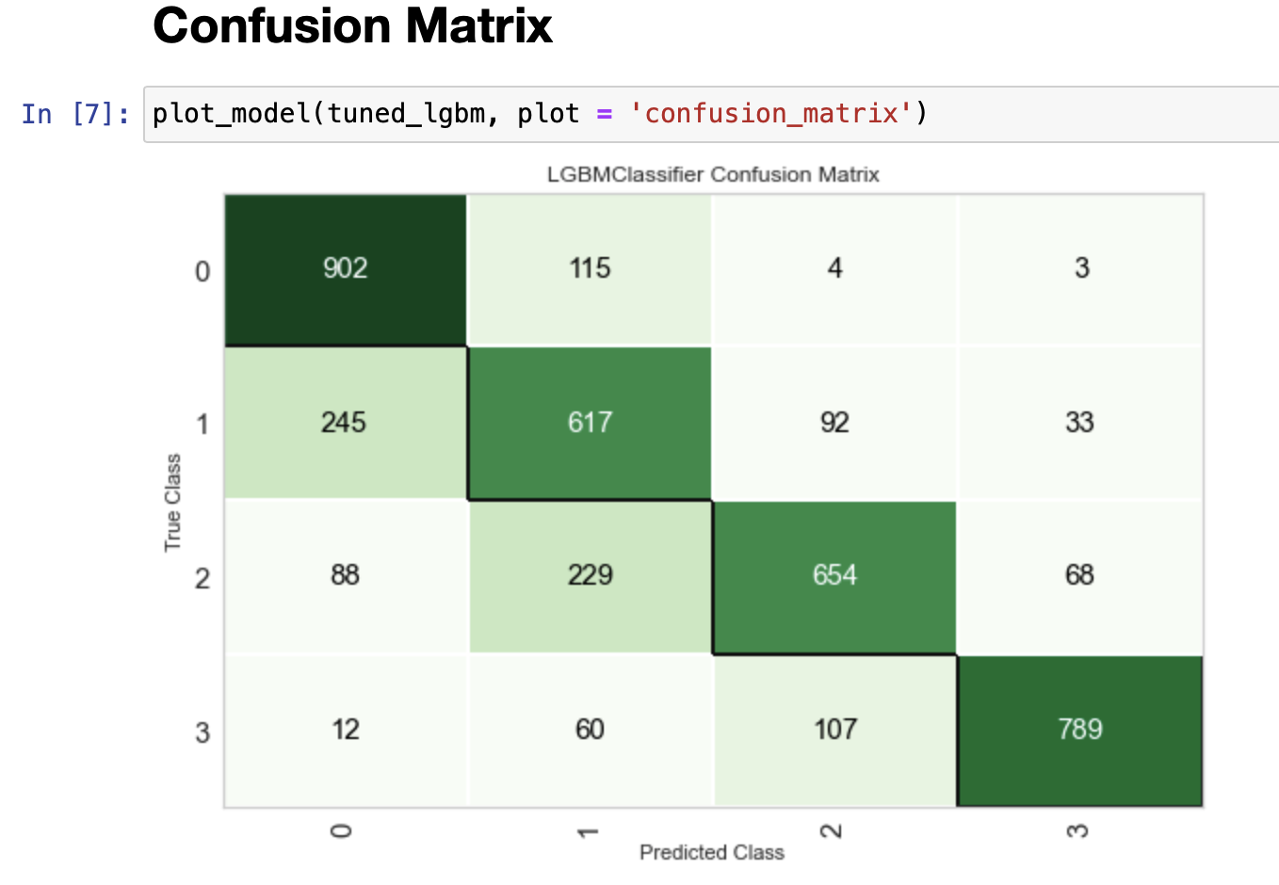
Plot model

Slide 17
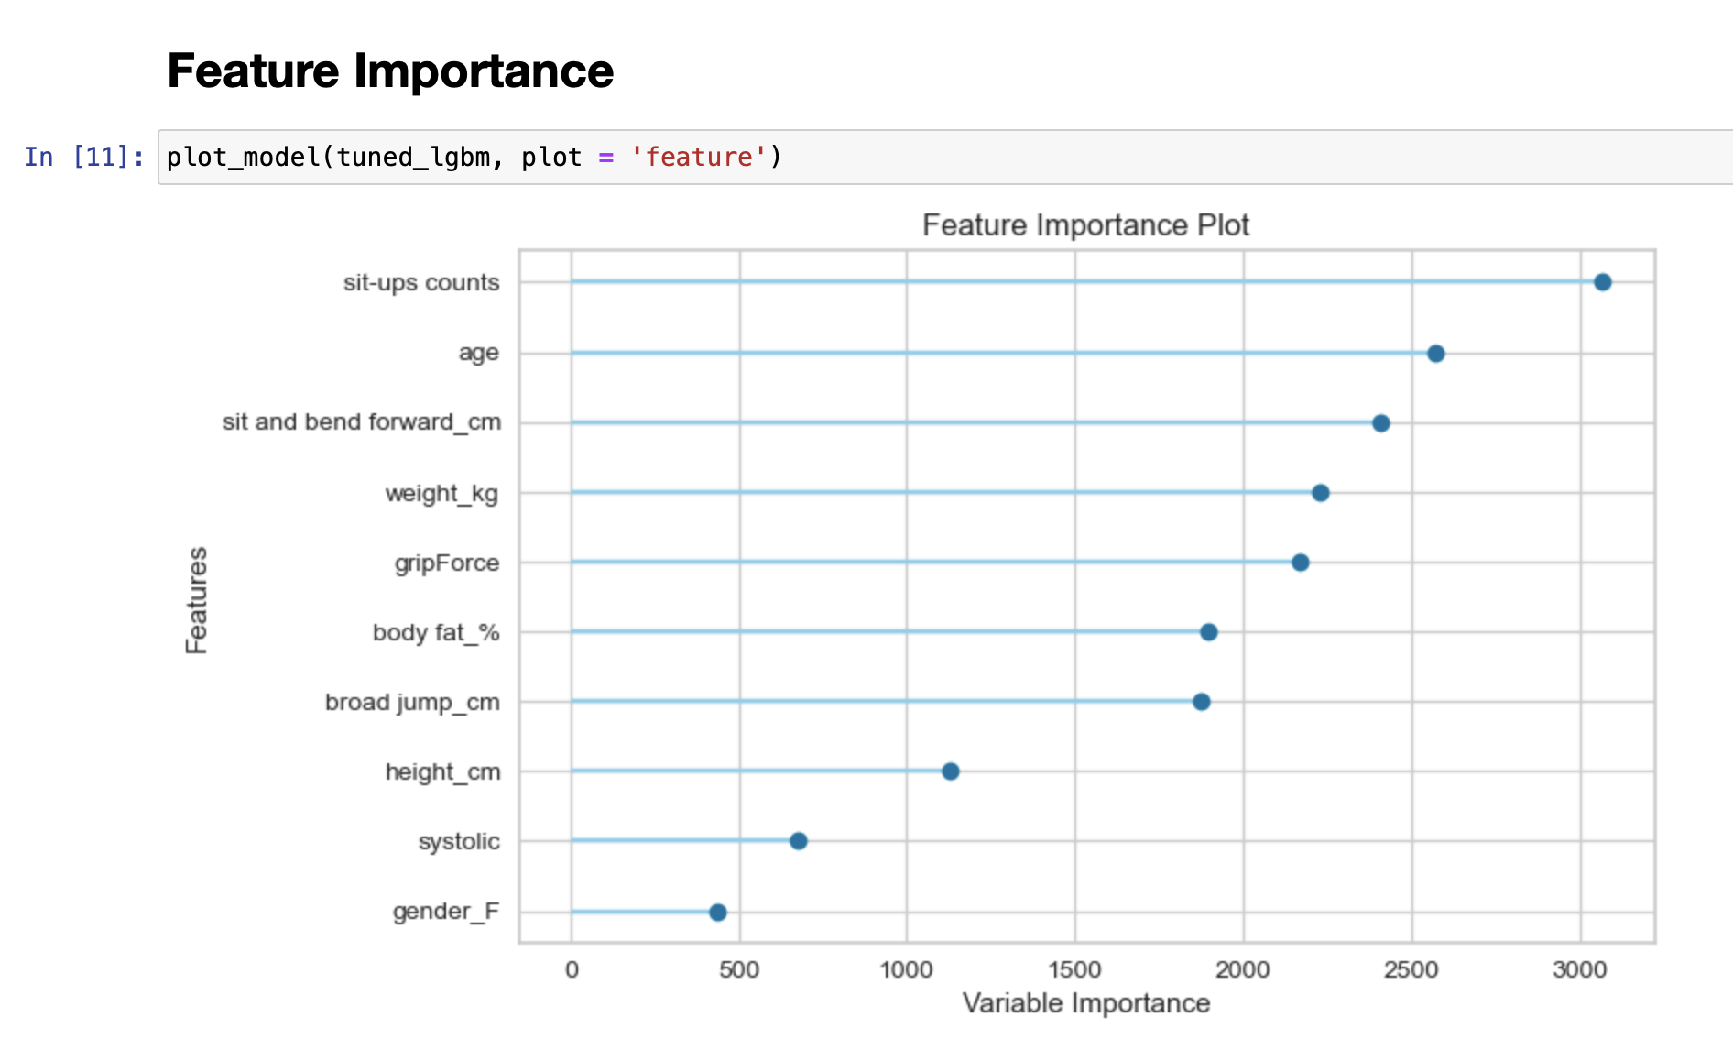
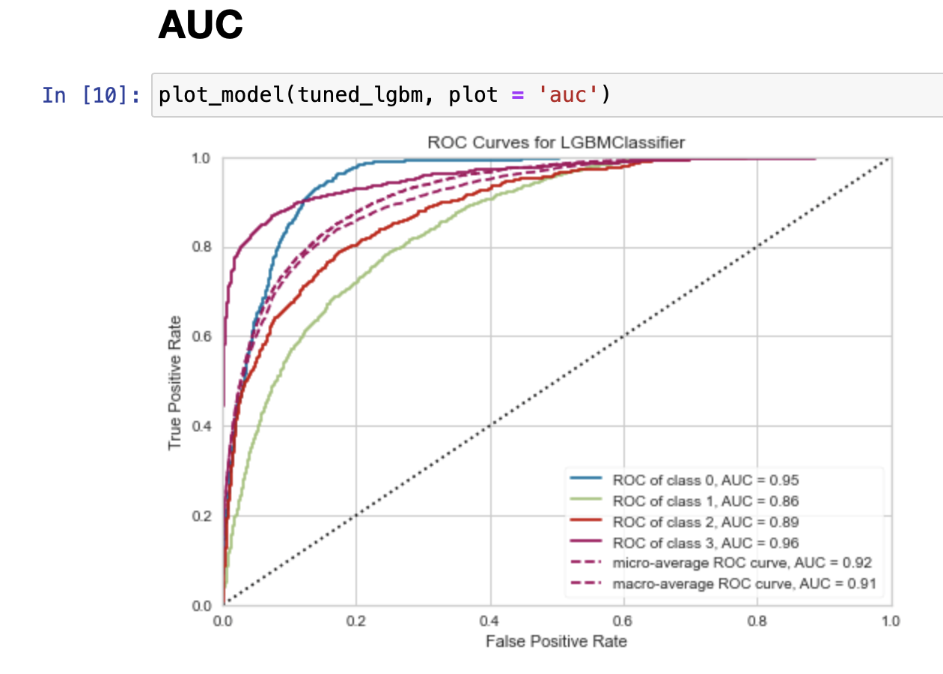

Slide 18
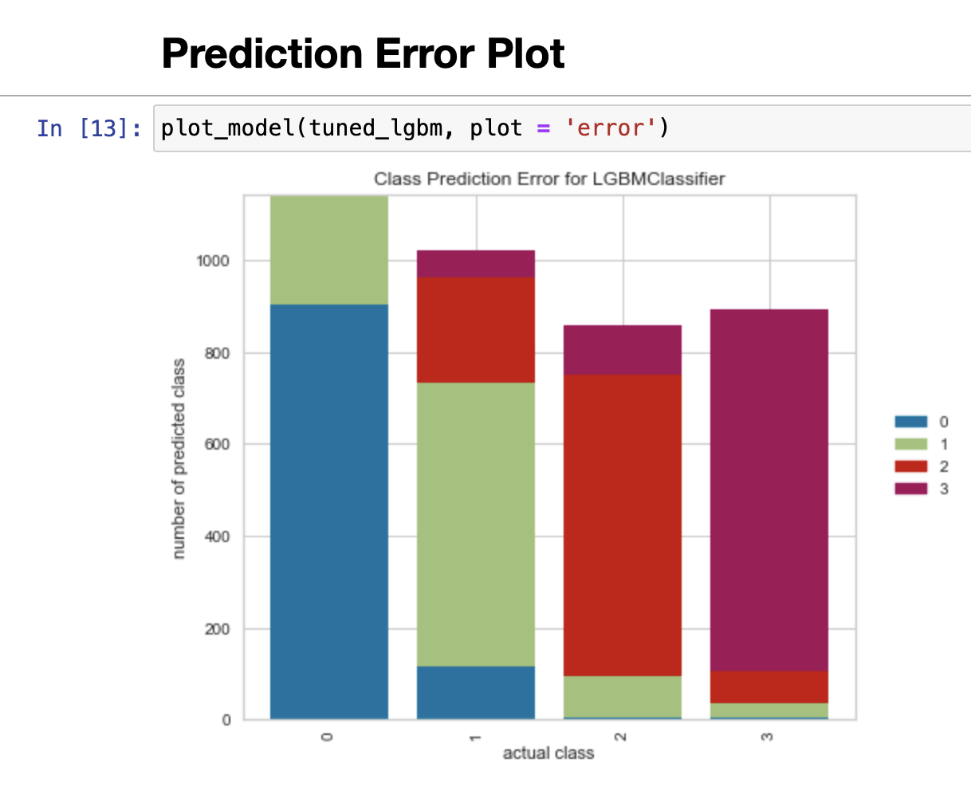
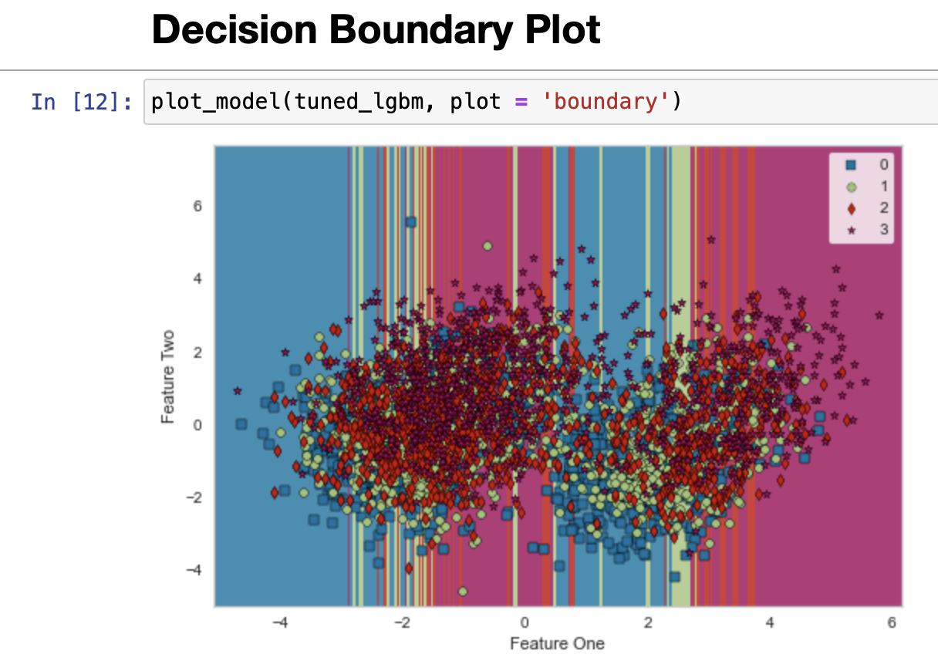

Slide 19
Recommendations
From analyzing the histogram we can see that male, ages of 20-30 and in class c have a higher body fat percentage, and higher diastolic and systolic blood pressure.
we can focus on creating courses/attract with advertisement that target the group who need needed the most to increase the gym/class subscriptions.

Slide 20
Future work
Obtain more body performance data with different ethnicity to further target the group to help them improve their performance.
Create different programs to target specific body performances.
Obtain information on what the criteria are for classifying in each class from the institution.

